Slide 1

Customer Segmentation Analysis Using Power BI
This presentation highlights the potential of Power BI in analyzing byster behavior to support data-driven decision-making. Using the pping_trends.csv dataset, we’ll explore how to clean, model, analyze, and visualize data to uncover valuable insights into customer segmentation.
DIVYANSHU SHARMA
MISHTY
SAI SWAPNA
SOUNDARYA
NAGA CHARANYA
BHARINI KUMAR

Slide 2
Power BI: A Data Analytics Powerhouse
What is Power BI?
Key Features
Power BI is a comprehensive business analytics platform that allows users to connect to diverse data sources, transform data into meaningful insights, and create interactive visualizations and reports. It's a user-friendly tool that empowers organizations to make informed decisions based on data.
Data Connectivity
Data Transformation
Data Modeling
Data Visualization
Interactive Dashboards

Slide 3
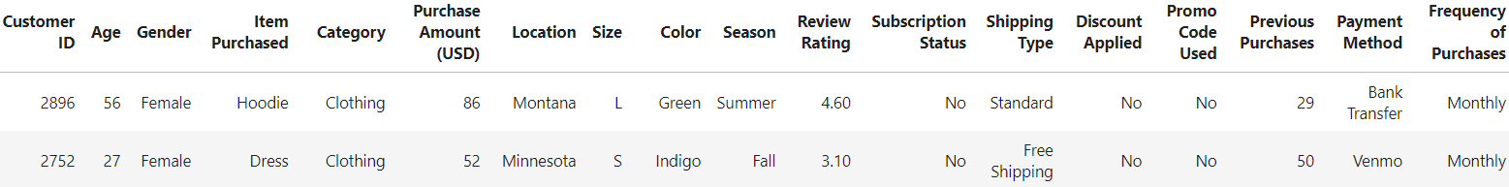
Understanding the 'shopping_trends.csv' Dataset
Dataset Context
The 'shopping_trends.csv' dataset is a synthetic dataset designed for educational purposes. It simulates real-world shopping data, providing a valuable resource for learning data analysis techniques. This dataset is readily available on Kaggle, a popular platform for data science enthusiasts.
Dataset Structure

Slide 4

Data Cleaning and Preprocessing
1
Handling Missing Data
2
Data Transformation
Identify and address missing data points using techniques like imputation or deletion, depending on the nature and extent of missing data.
Transform data to ensure consistency and facilitate analysis. This may involve pivoting, unpivoting, or changing data types.
3
Data Validation
Validate data for accuracy and consistency, ensuring data integrity and reliability for further analysis.

Slide 5
Data Modeling in Power BI
Data modeling is the process of organizing and structuring data to define relationships between different data points. In Power BI, it involves connecting tables, creating calculated columns or measures, and ensuring the data is ready for analysis and visualization.
Relationships between Tables
Calculated Columns and Measures
Establish relationships between different tables based on common columns, creating a logical data model that allows for efficient data querying and analysis.
Create calculated columns and measures to derive new data points and metrics from existing data, enhancing the analytical capabilities of the dataset.

Slide 6




Power BI Data Analysis Expressions (DAX)
FILTER
AVERAGEX
Some more queries are
Used to filter rows in a table based on a condition. For example, you can filter customers based on their age or location.
Calculates the average of a specific column for a group of rows, providing insights into average purchase amounts or customer ages.
MAX
DIVIDE
COUNT / DISTINCTCOUNT
CALCULATE
IF / SWITCH
AND (&&) / OR(||)
DATEADD / SAMEPERIODLASTYEAR
KEEPFILTERS
SELECTEDVALUE
USERELATIONSHIP
SUM/SUMX
CALCULATE
Calculates the sum of values in a column, allowing you to determine total revenue generated by a specific customer segment.
Allows for complex calculations by modifying the context of a measure, enabling the analysis of data under specific conditions or scenarios.

Slide 7
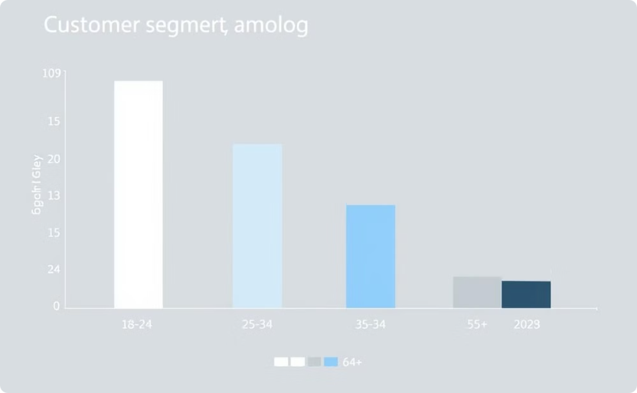
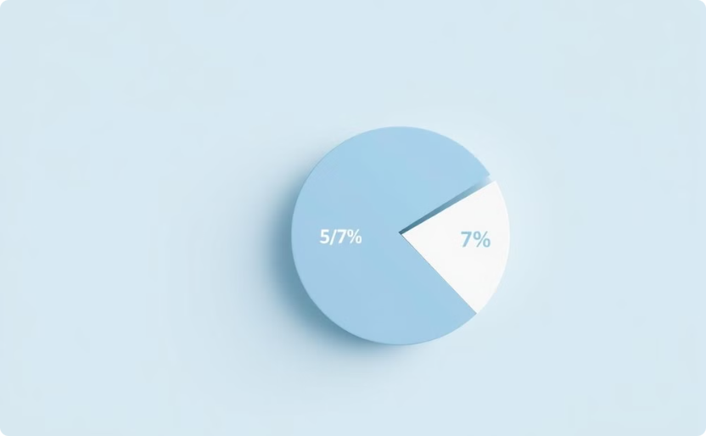
Visualizing Customer Segments
Age Segmentation
Gender Segmentation
Analyze customer segments based on their age group to identify purchasing patterns and tailor marketing strategies accordingly.
Understand the purchasing preferences of different genders, creating targeted campaigns based on gender-specific interests.

Slide 8



Insights and Applications
Customer Loyalty
1
Identify customers with high purchase frequency and high-value transactions, indicating strong brand loyalty and potential for targeted promotions.
Product Affinity
2
Analyze the product categories purchased by different customer segments to understand their preferences and recommend complementary products.
Market Segmentation
3
Use location and demographic data to segment customers geographically and identify potential markets for expansion.

Slide 9

Conclusion and Next Steps
By leveraging Power BI's capabilities for data cleaning, modeling, and visualization, you can unlock valuable insights into customer behavior and inform business strategies. The shopping_trends.csv dataset provides a solid foundation for learning and applying these techniques. The next step is to implement these insights into your business operations and monitor their impact on key metrics.

Slide 10
THANK YOU

